Slide 1
ARTIFICIAL INTELLIGENCE (18CSC305J)
MINI PROJECT
- RA1911033010124 SIDHARTH S KADVATH
RA1911033010098 SHRESHTH PALIYAL
RA19110330101

Slide 2
DATA ANALYSIS OF ZOMATO

Slide 3
WHAT IS DATA ANALYSIS ?
Data analysis is the practice of working with data to glean useful information, which can then be used to make informed decisions.

Slide 4
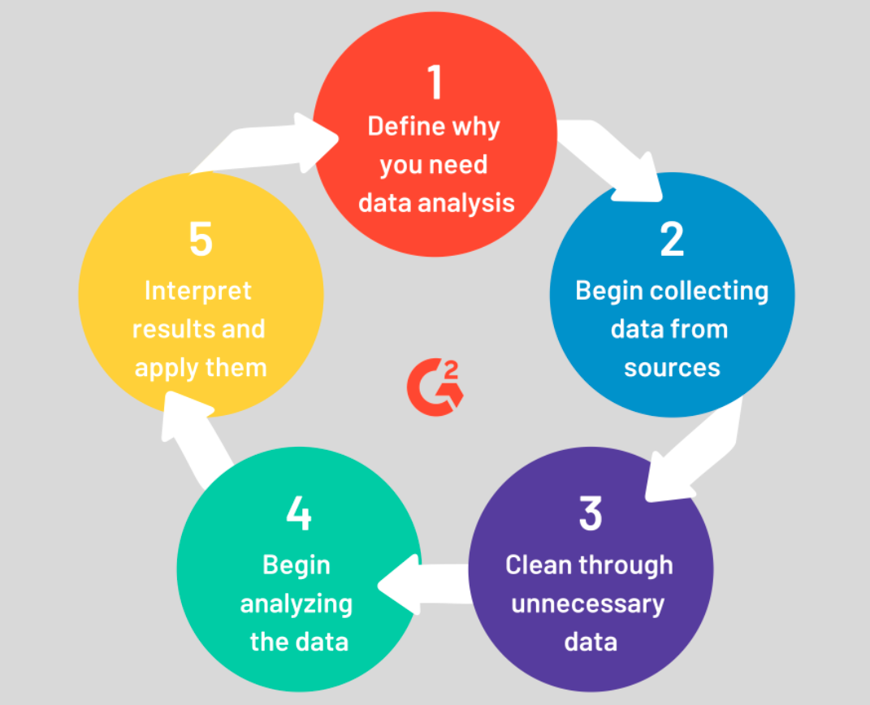

Slide 5
PROBLEM STATEMENT
The problem in data analysis is going through a set amount of raw data and segregating according to user set conditions.
In this project, we try to implement a Zomato data analysis model that helps to overcome the challenges of identifying the preference/requirements of customers with the help of collected data.

Slide 6
OBJECTIVE
To implement a metod for classification of the data to meet our desired requirements.
Data analysis to provide a deep insight into the requirement of the masses for Zomato and, in turn, to provide the most refined and quality experience to the users.
Graphical representation of the analysed data in the form of a pie-chart/graphs.

Slide 7
ISSUES IN EXISTING SYSTEM
Lost potential for growth of underrated restaurants/cuisines due to no idea/data regarding preference of the masses.
Unsatisfied customers ordering from restaurants far away from them, causing inconvenience for customers/drivers/staff etc.

Slide 8
WORKING(INFERENCES)
Hotel distribution WRT to localities.
What kind of cuisine do these highly rated restaurants offer.
How many of such restaurants accept online delivery.
Understanding the Restaurants Rating localities.
Rating VS Cost of dining.
Location of Highly rated restaurants across New Delhi.
Common Eateries.

Slide 9
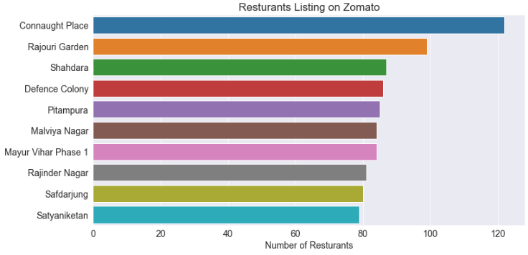
1.Hotel distribution WRT to localities.

Slide 10
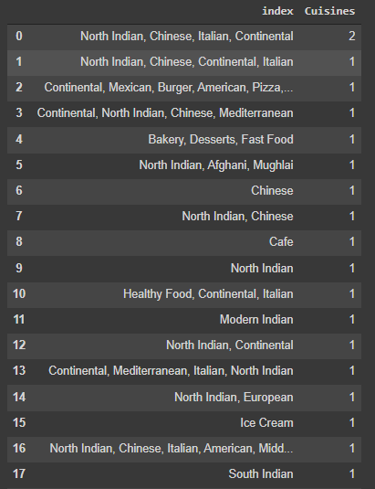
2.Cuisine served at highly rated restaurants.

Slide 11
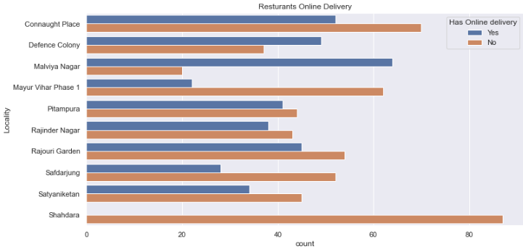
3. Restaurants with online delivery

Slide 12
4.Understanding the Restaurants Rating localities.

Slide 13
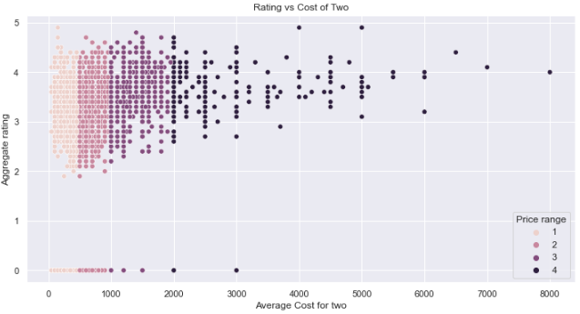
5.Rating VS Cost of dining.

Slide 14
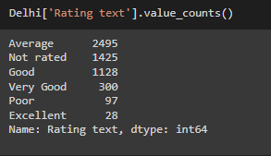
6. Location of Highly rated restaurants across New Delhi.

Slide 15
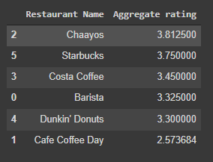
7.Common Eateries.

Slide 16
FUTURE ADDITIONS
To implement a method to classify restaurants according to zomato pro benefits.
To be able to classify/possibly blacklist certain restaurants according to received complaints.

Slide 17
SOCIETAL BENEFITS.
Helping zomato segregate restaurants according to the data collected from the masses.
Providing the best quality food for the masses.
Helping underrated yet quality franchises/cuisines grow.

